Slide 1
‘Can You Tell It’s Sickle Cell?’
+
‘Not Family, But Blood’
campaign comms toolkit

Slide 2
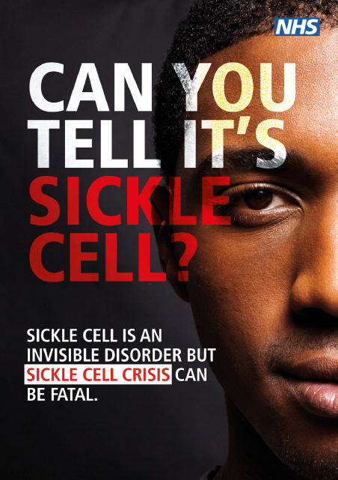
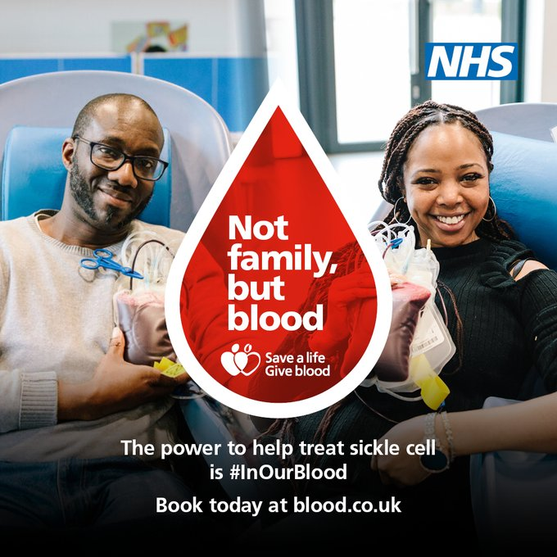
What is the campaign?
Overview
NHS England launched a new sickle cell awareness campaign – ‘Can You Tell It’s Sickle Cell?’ – earlier this year, aiming to increase understanding of the key signs and symptoms of a sickle cell crisis, particularly among urgent emergency care staff and those living with the condition and their carers.
NHS Blood and Transplant are now launching their own campaign – Not Family, But Blood – calling for more people of Black heritage to become blood donors. New figures reveal that a record 250 donations are now needed every day to treat sickle cell disease, an increase of 52% in five years.

Slide 3
Audience and insight
Audience(s)
NHS urgent and emergency care workers
GPs, practice nurses, and other primary care staff​
People living with sickle cell disease and their carers
Prospective blood donors, particularly those of Black heritage
Key insight
Approximately 15,000 people in the UK have sickle cell disorder. Almost 300 babies are born in the UK with sickle cell each year. Sickle cell disorder can affect anyone, although it predominantly affects people from African and Caribbean backgrounds.
People with sickle cell are at risk of complications including stroke, acute chest syndrome, blindness and bone damage, and experience episodes of severe pain know as sickle cell crises.
Sickle cell is the fastest growing genetic condition in the UK - demand for blood to treat the condition has risen by 52% over the past five years and is projected to continue to rise.
NHS Blood and Transplant needs to collect 1.45 million units of blood each year to meet the needs of patients across England. There is an urgent need for donors with Ro blood. Only 2% of our donors have Ro type blood. Collecting enough is a constant challenge. Ro blood is ten times more common in black people than in white people.

Slide 4
Key messages
‘Can You Tell It’s Sickle Cell?’ campaign
NHS England’s new sickle cell awareness campaign, part of a bigger drive to improve sickle cell care across the NHS, aims to increase awareness of the key signs and symptoms of a crisis. Anyone can be born with Sickle Cell disorder, but it is most common amongst people from a black Caribbean or black African background.
Immediate action should be taken if an individual has any of the following symptoms, as they could be signs of a crisis or complication: pain; fever; one-sided paralysis or weakness in the face, arms or legs; confusion; difficulty walking or talking; sudden visual changes; unexplained numbers; severe headaches, breathlessness, chest pain or dizziness.
‘Not Family, But Blood’ campaign
Launched to coincide with Black History Month, the campaign highlights that although the Black community is diverse, one unifying thing is the power to treat sickle cell and provide life changing blood donations.
Sickle cell is more prevalent in people of Black heritage and ethnically matched blood provides the best treatment, but more Black donors are urgently needed to meet the increasing demand.
The rising demand is driven by increasing patient numbers, as people live for longer, and greater use of complete blood transfusions – known as red cell exchanges – which improve patient outcomes.
Please use the below NHS comment in support of the blood donor campaign
NHS England Director of Healthcare Inequalities Improvement and GP, Dr Bola Owolabi, said: “Sickle cell disproportionately affects people from a Black African or Black Caribbean background, and these new figures show hospitals need more blood for people with sickle cell disease than ever before. I urge anyone from these communities who is able to give blood to step forward and help treat the thousands of people living with this painful hereditary condition.”

Slide 5
Key messages
Call to action
If someone has symptoms of a crisis, they should seek urgent medical attention –via A&E, 999 or their local haematology unit – and be treated immediately.
NHS staff can complete a new free e-learning module to support increased knowledge of the condition and how to treat it. The training module also includes information on healthcare inequalities related to the condition: https://www.e-lfh.org.uk/programmes/health-inequalities/
Become a blood donor through the GiveBloodNHS app, by calling 0300 123 23 23, or by visiting www.blood.co.uk. If a local session is full, please book an appointment for a later date – your blood is still needed, and you will save lives.
There are free, curriculum-linked, online resources for secondary school teachers in England, to help educate Key Stage 3 and 4 students (11-16-year-olds) about blood, organ and stem cell donation. Visit www.nhsbt.nhs.uk/teaching-resources to find out more.

Slide 6
Key messages
Secondary messages
Sickle cell disorder is the name for a group of inherited red blood cell disorders. The most serious type is called sickle cell anaemia. People with sickle cell disease produce unusually shaped red blood cells that can cause excruciating pain and other problems.
Painful episodes are referred to as sickle cell crises. Treatment includes strong painkillers such as morphine to control the pain, intravenous fluids and oxygen. All patients presenting with acute sickle pain should receive initial analgesia within 30 minutes and have achieved good pain relief within two hours.
Over half of sickle cell disease patients living in the most deprived areas experience re-admission to hospital in comparison with 28% among those hospitalised from the least deprived areas. Sickle cell patients admitted from the most deprived areas are twice as likely to die in hospital in comparison with those admitted from the least deprived areas.
NHS struck a deal last October to roll out the first sickle cell treatment in 20 years – a drug called crizanlizumab which will help up to 5,000 over three years to have a much better quality of life.
The overall demand for blood is falling by 3-4% per year due to improvements in clinical practice and our work with hospitals to ensure blood is used appropriately for patients.
We need up to 200,000 new blood donors each year to replace those who stop donating and to ensure we have the right mix of blood groups to match patient needs in the future. We urgently need more black donors as they are more likely to have the blood type needed to treat the increasing number of patients suffering from sickle cell disease.

Slide 7
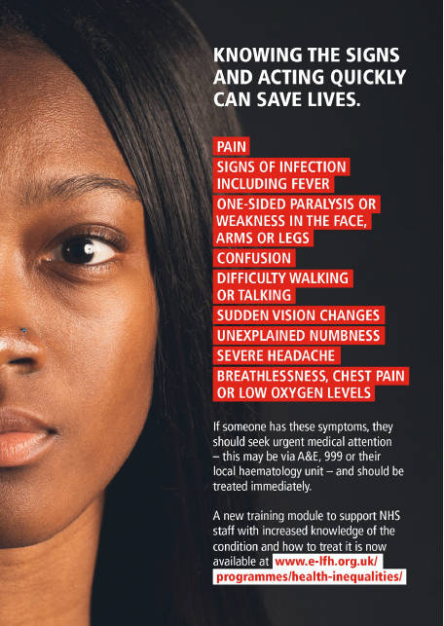
Top ways to help
Download resources and materials for both campaigns and promote via social media, bulletins, community and staff networks, and other communication methods.
Encourage clinical staff to complete the e-learning module on sickle cell disease.
Produce regionalised press releases, including local stats and case studies about individuals living with sickle cell in local areas, and what is being done to improve care.
Promote the benefits of blood donation and how donors can improve and save lives.
Share the online resources available for secondary school teachers in England to help education 11-16-year-olds about blood, organ, and stem cell donation.
NHSBT has 25 permanent donor centres across the country, and mobile teams also collect blood at community venues such as church halls – get in touch to see how you can help.

Slide 8
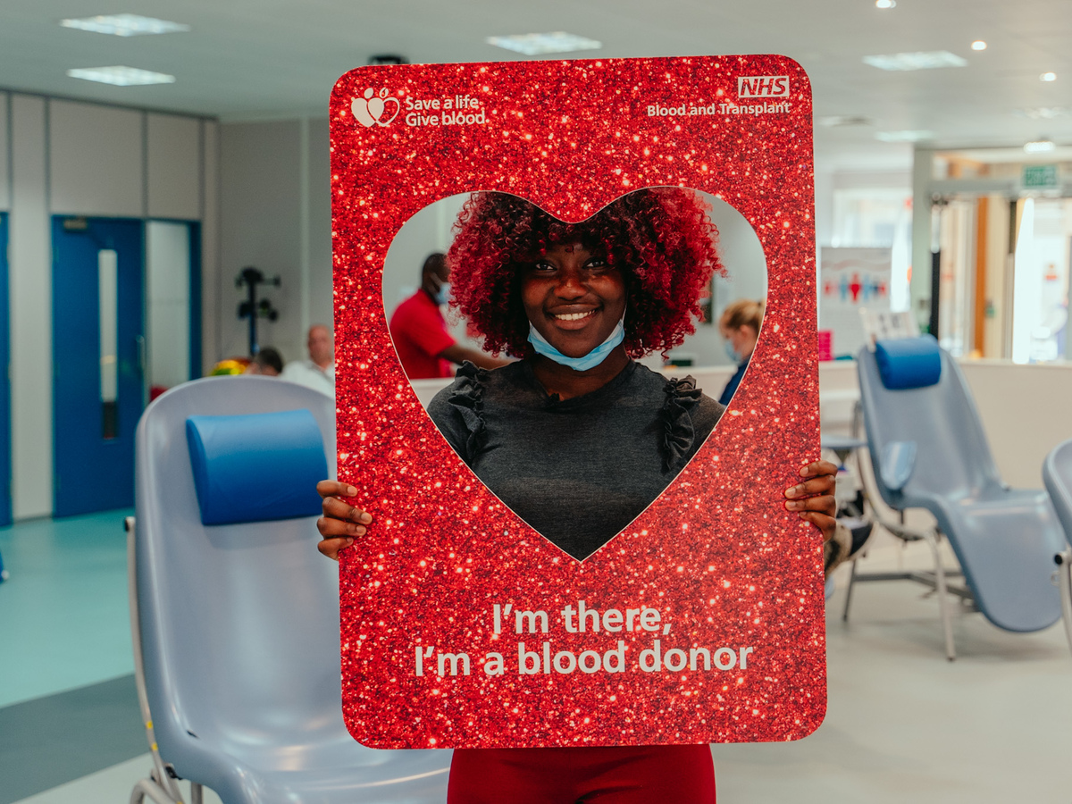
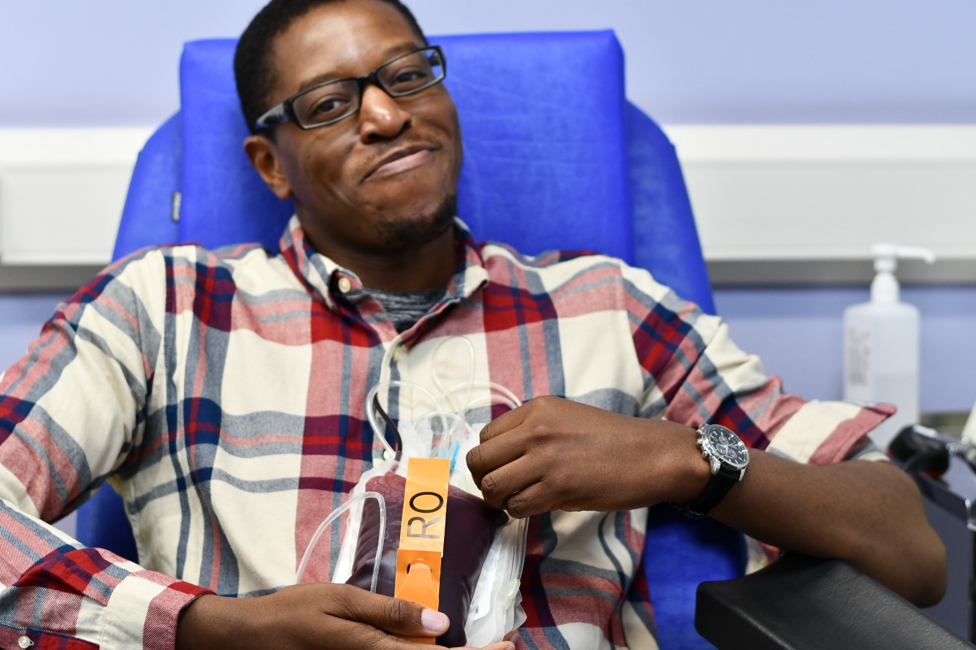
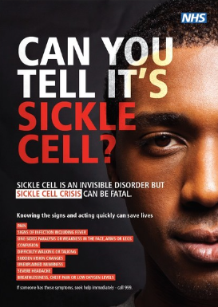
Resources to use
All resources for the ‘Can You Tell It’s Sickle Cell?’ campaign are available on the Campaign Resource Centre now.
Head to www.blood.co.uk for information and resources on NHSBT’s ‘Not Family, But Blood’ campaign.

Slide 9
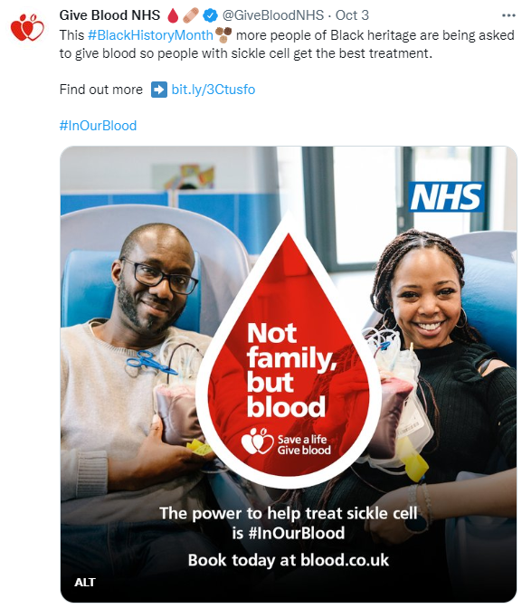
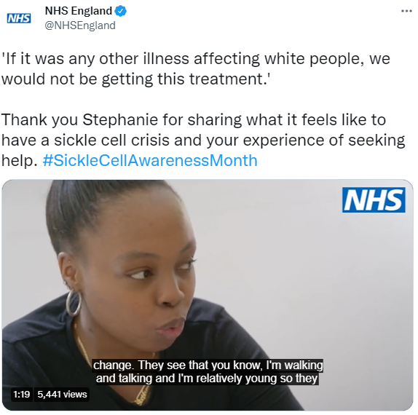
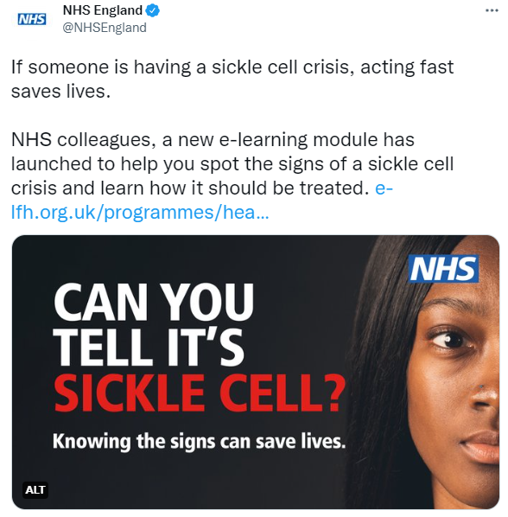
Example social media posts
Example posts for Twitter

Slide 10
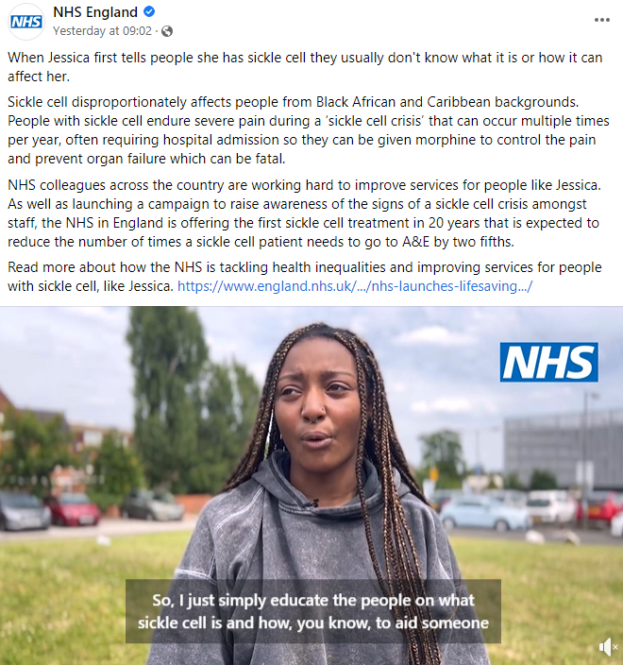
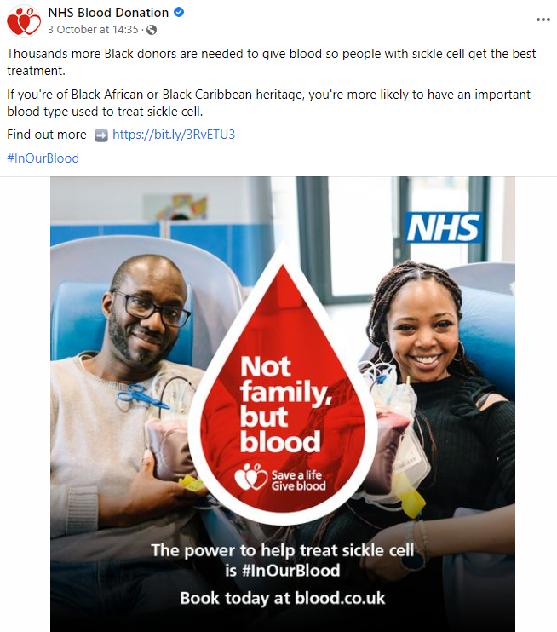
Example social media posts
Example posts for Facebook

Slide 11
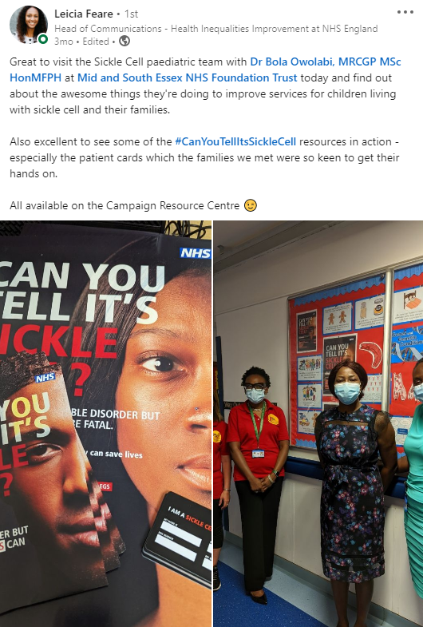
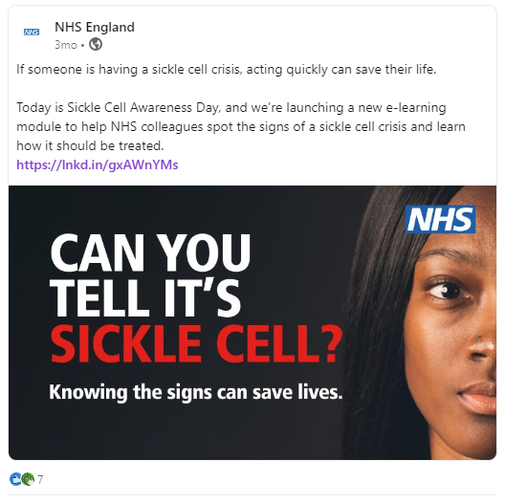
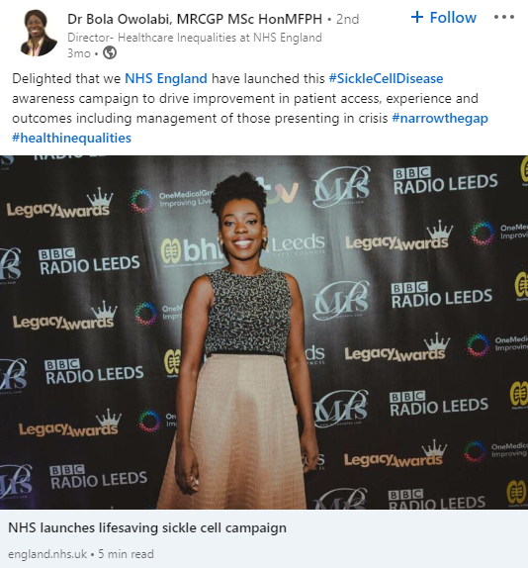
Example social media posts
Example posts for LinkedIn

Slide 12
Example copy
Can You Tell It’s Sickle Cell?
The campaign is aimed at increasing awareness of the key signs and symptoms of sickle cell disorder – which disproportionately affects people from Black African and Caribbean backgrounds – among emergency care staff, carers and the wider public.
A brand new NHS training programme will also help staff better understand the condition, crises, and how to care for patients during their greatest hour of need.
It comes less than a year after the NHS struck a deal to roll out the first sickle cell treatment in 20 years, which will help as many as 5,000 people over three years to have a much better quality of life.
People with the disorder endure severe pain during a ‘sickle cell crisis’ that can occur multiple times per year, often requiring hospital admission so they can be given morphine to control the pain and prevent organ failure which can be fatal. Symptoms of a crisis include – but are not limited to – severe pain, fever, one-sided paralysis, difficulty walking, sudden vision changes and confusion.
The NHS has also overhauled the way it treats sickle cell disease. There are 10 dedicated sickle cell centres which are supported by 24 specialist teams across the country.

Slide 13
Example copy
Not Family, But Blood
The NHS is making an urgent call for more blood donors of Black heritage as new figures reveal a record 250* donations are now needed every day to treat sickle cell, the fastest growing genetic condition in the UK.
The figure shows a huge increase in demand from hospitals to treat patients. Only 150 donations a day were needed five years ago.
Sickle cell is more prevalent in people of Black heritage and ethnically matched blood provides the best treatment. More Black donors are urgently needed to meet the increasing demand.
NHS Blood and Transplant is this week launching a new campaign titled ‘Not Family, But Blood’ to recruit more donors of Black heritage.
Launched to coincide with Black History Month, the campaign highlights that although the Black community is diverse, one unifying thing is the power to treat sickle cell and provide life changing blood donations.
Demand for blood to treat sickle cell has risen by 52% over the past five years and is projected to continue to rise.

