Slide 2
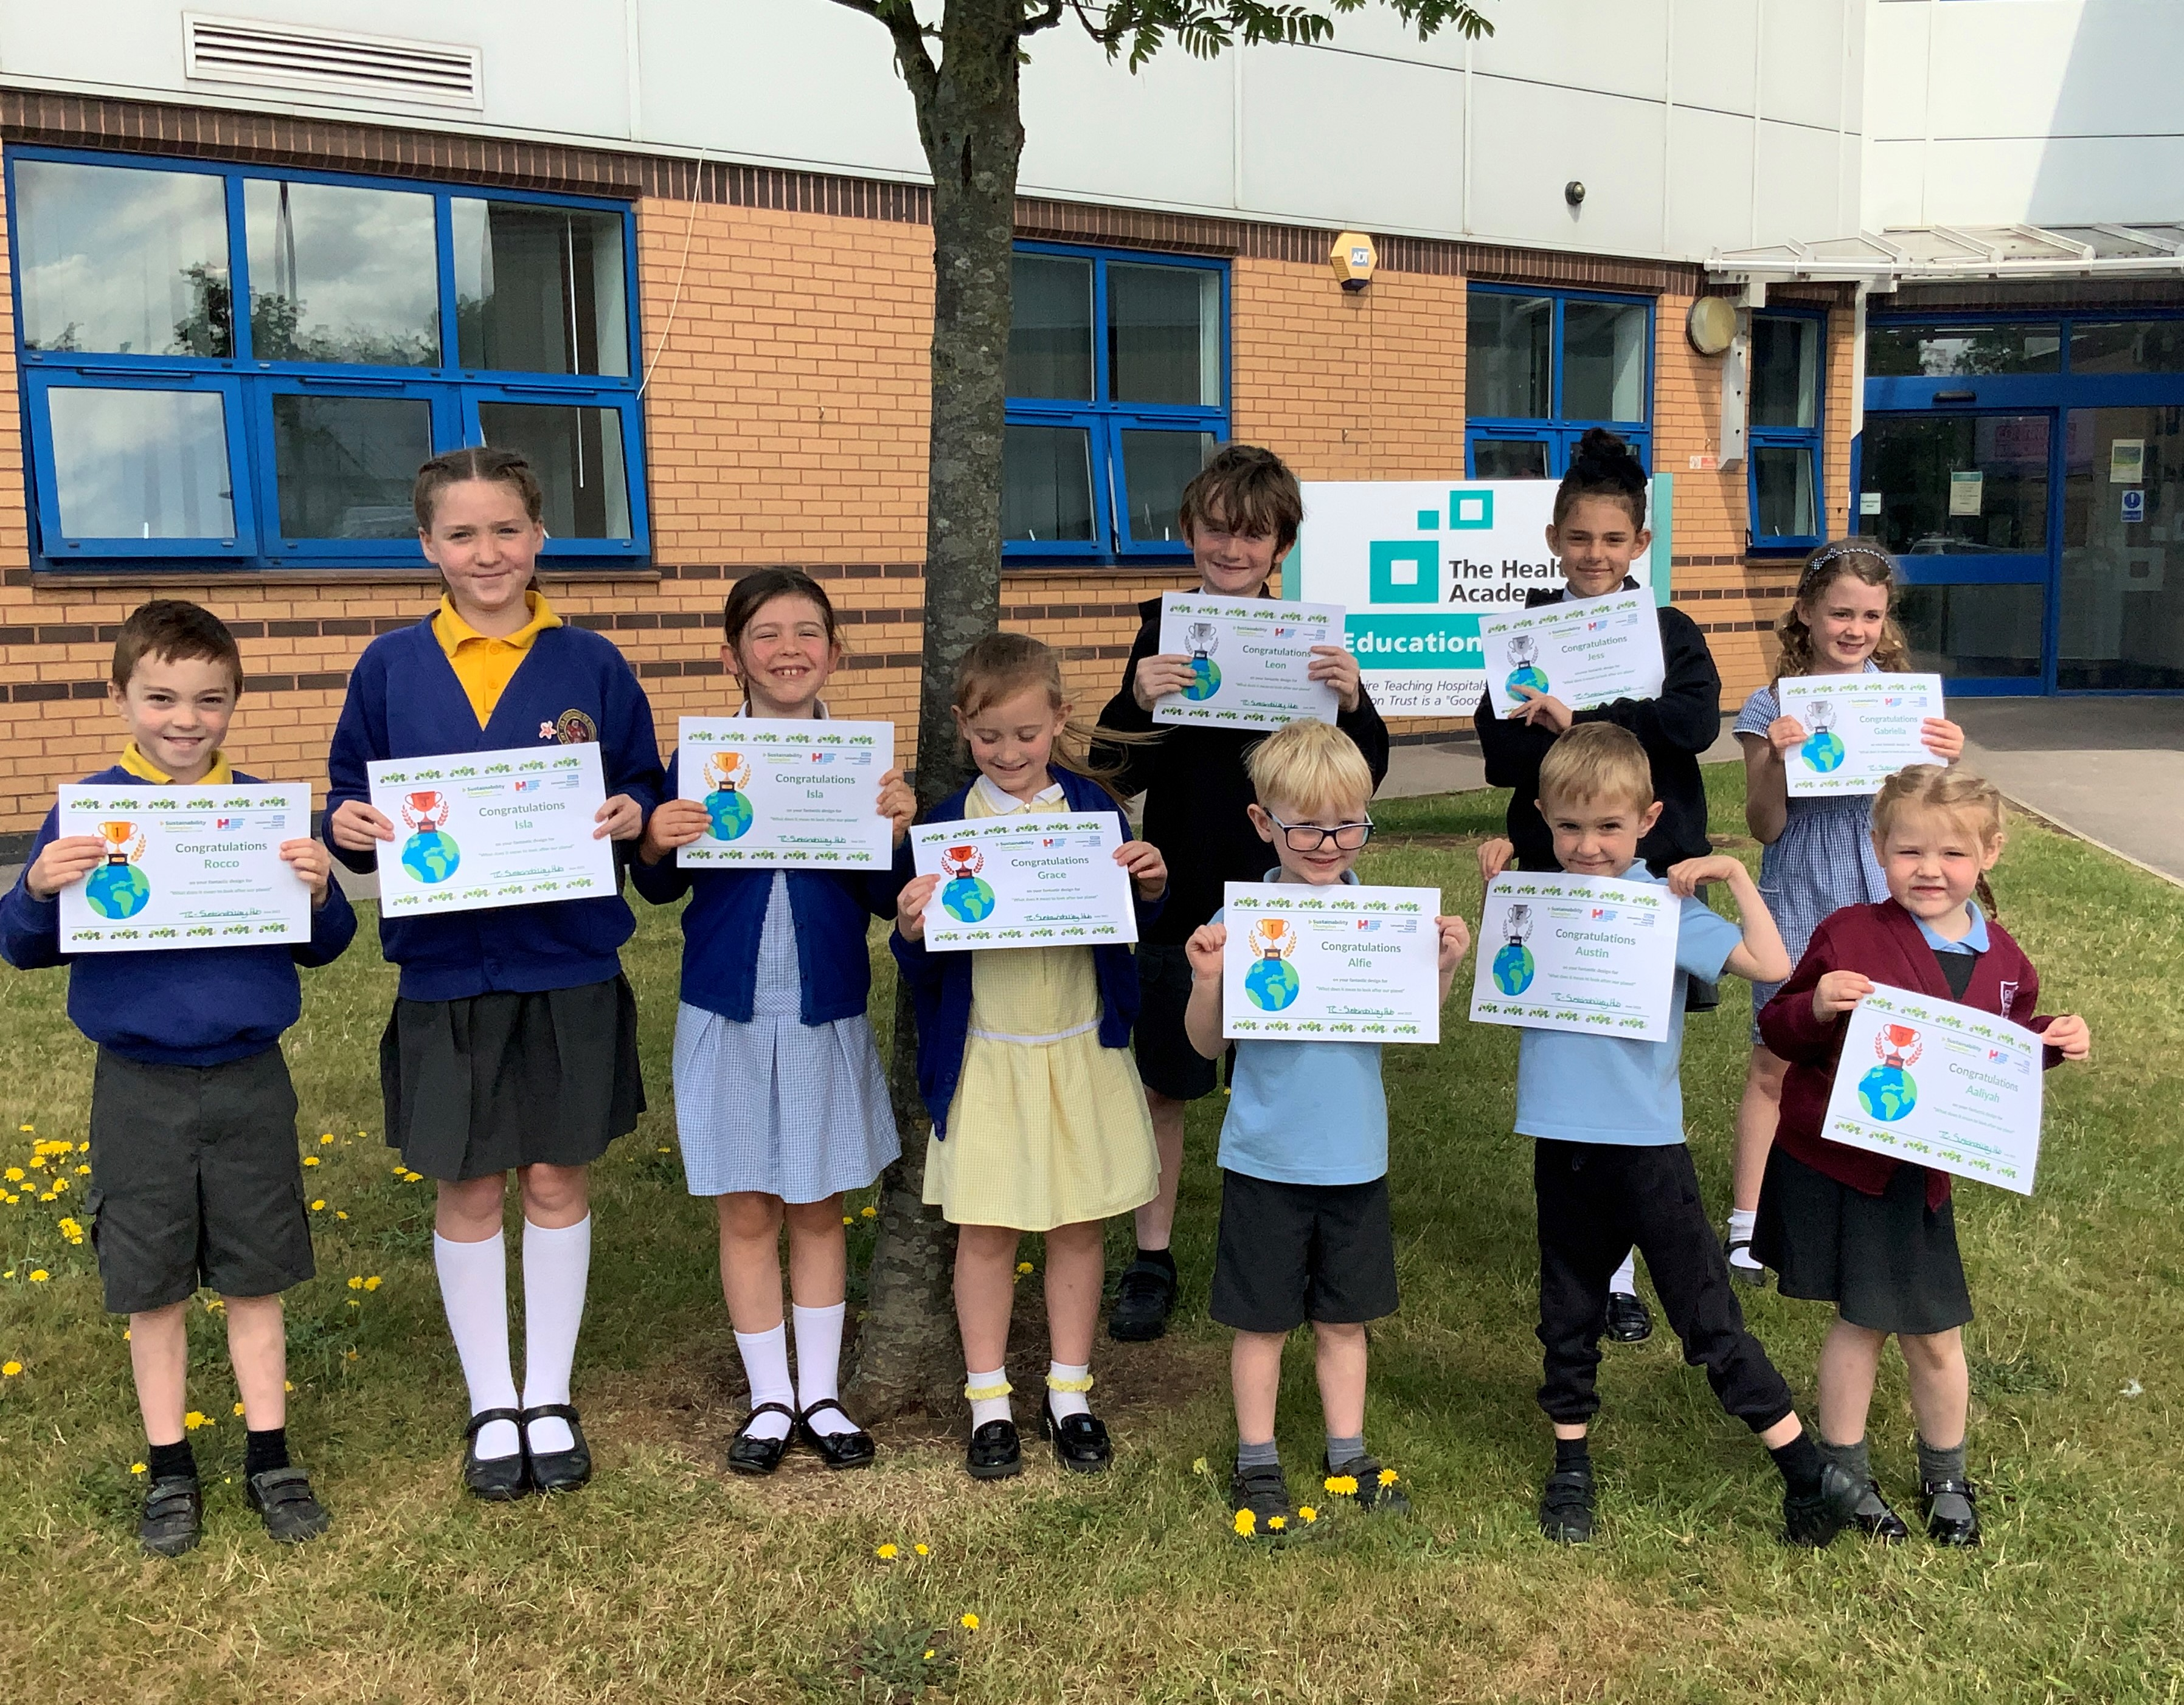
Meet all our Sustainability Art Competition Winners
Left to Right:
Rocco – Lea Endowed Primary School
Isla – Lea Endowed Primary School
Isla – Lea Endowed Primary School
Grace – Lea Endowed Primary School
Leon (Top) – Kingsfold Primary School
Alfie – Euxton CE Primary School
Jess (Top) – Kingsfold Primary School
Austin – Penwortham Primary School
Gabriella (Top) – Sherwood Primary School
Aaliyah – Penwortham Primary School
Well done to all our winners!!

Slide 3
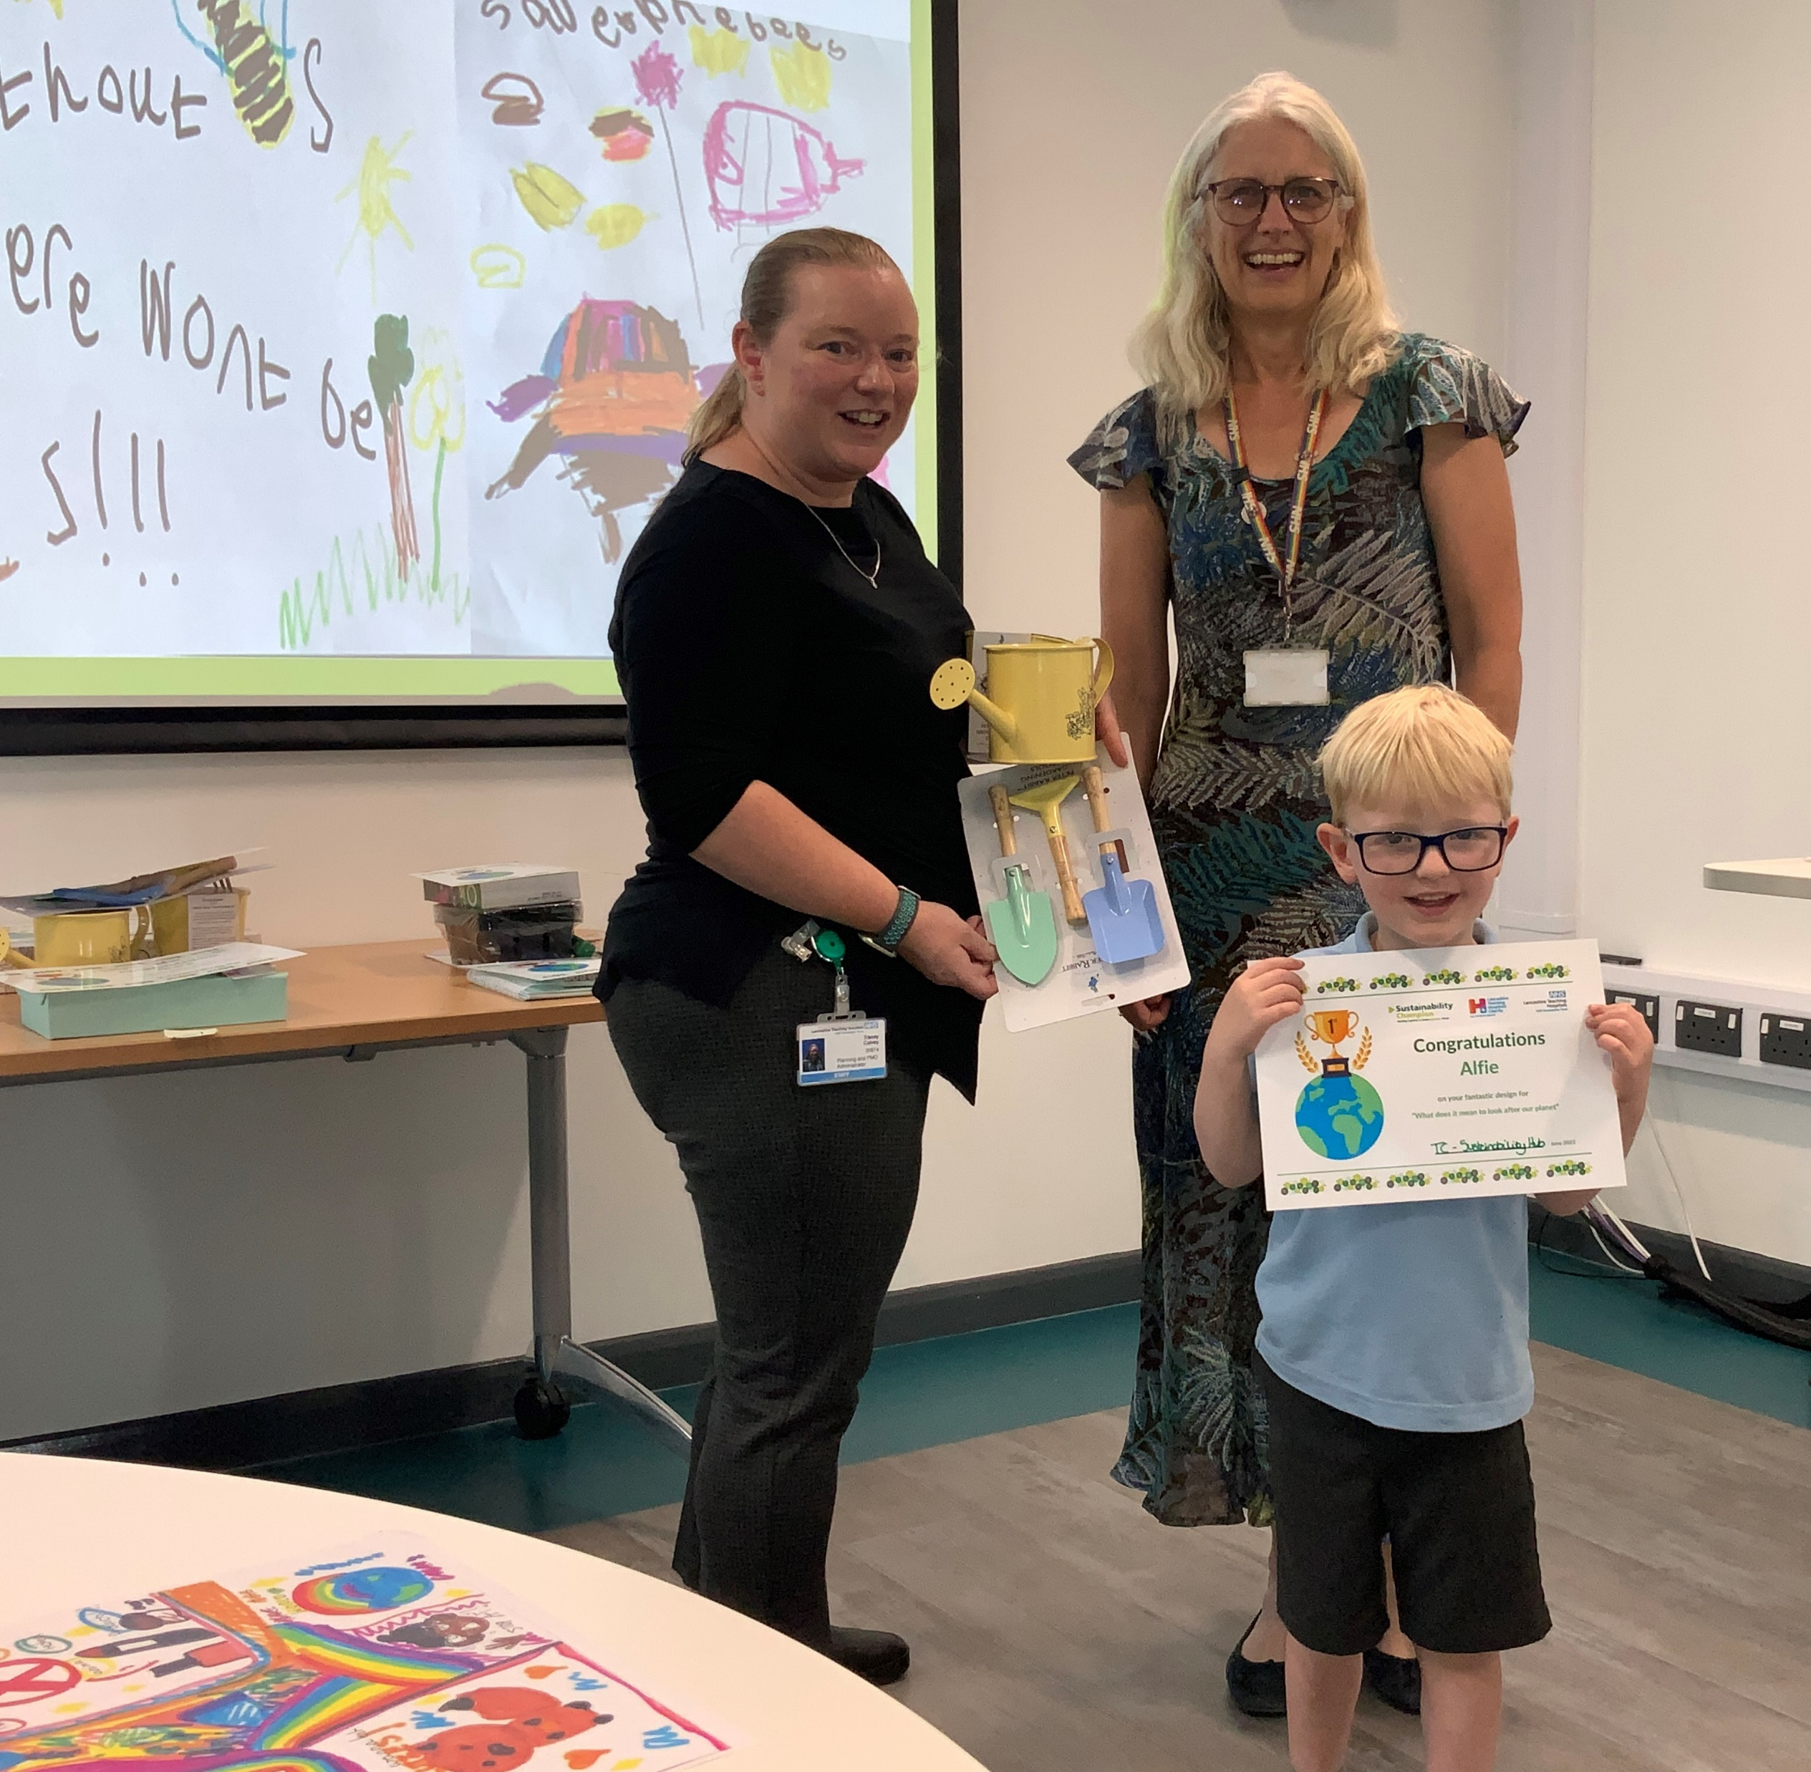
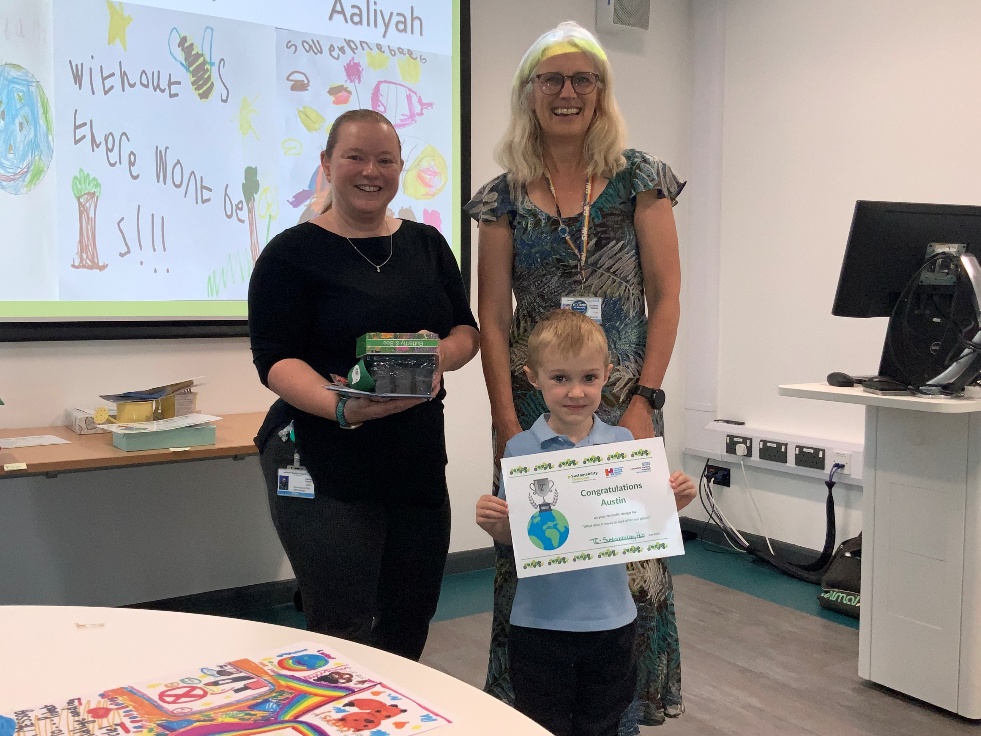
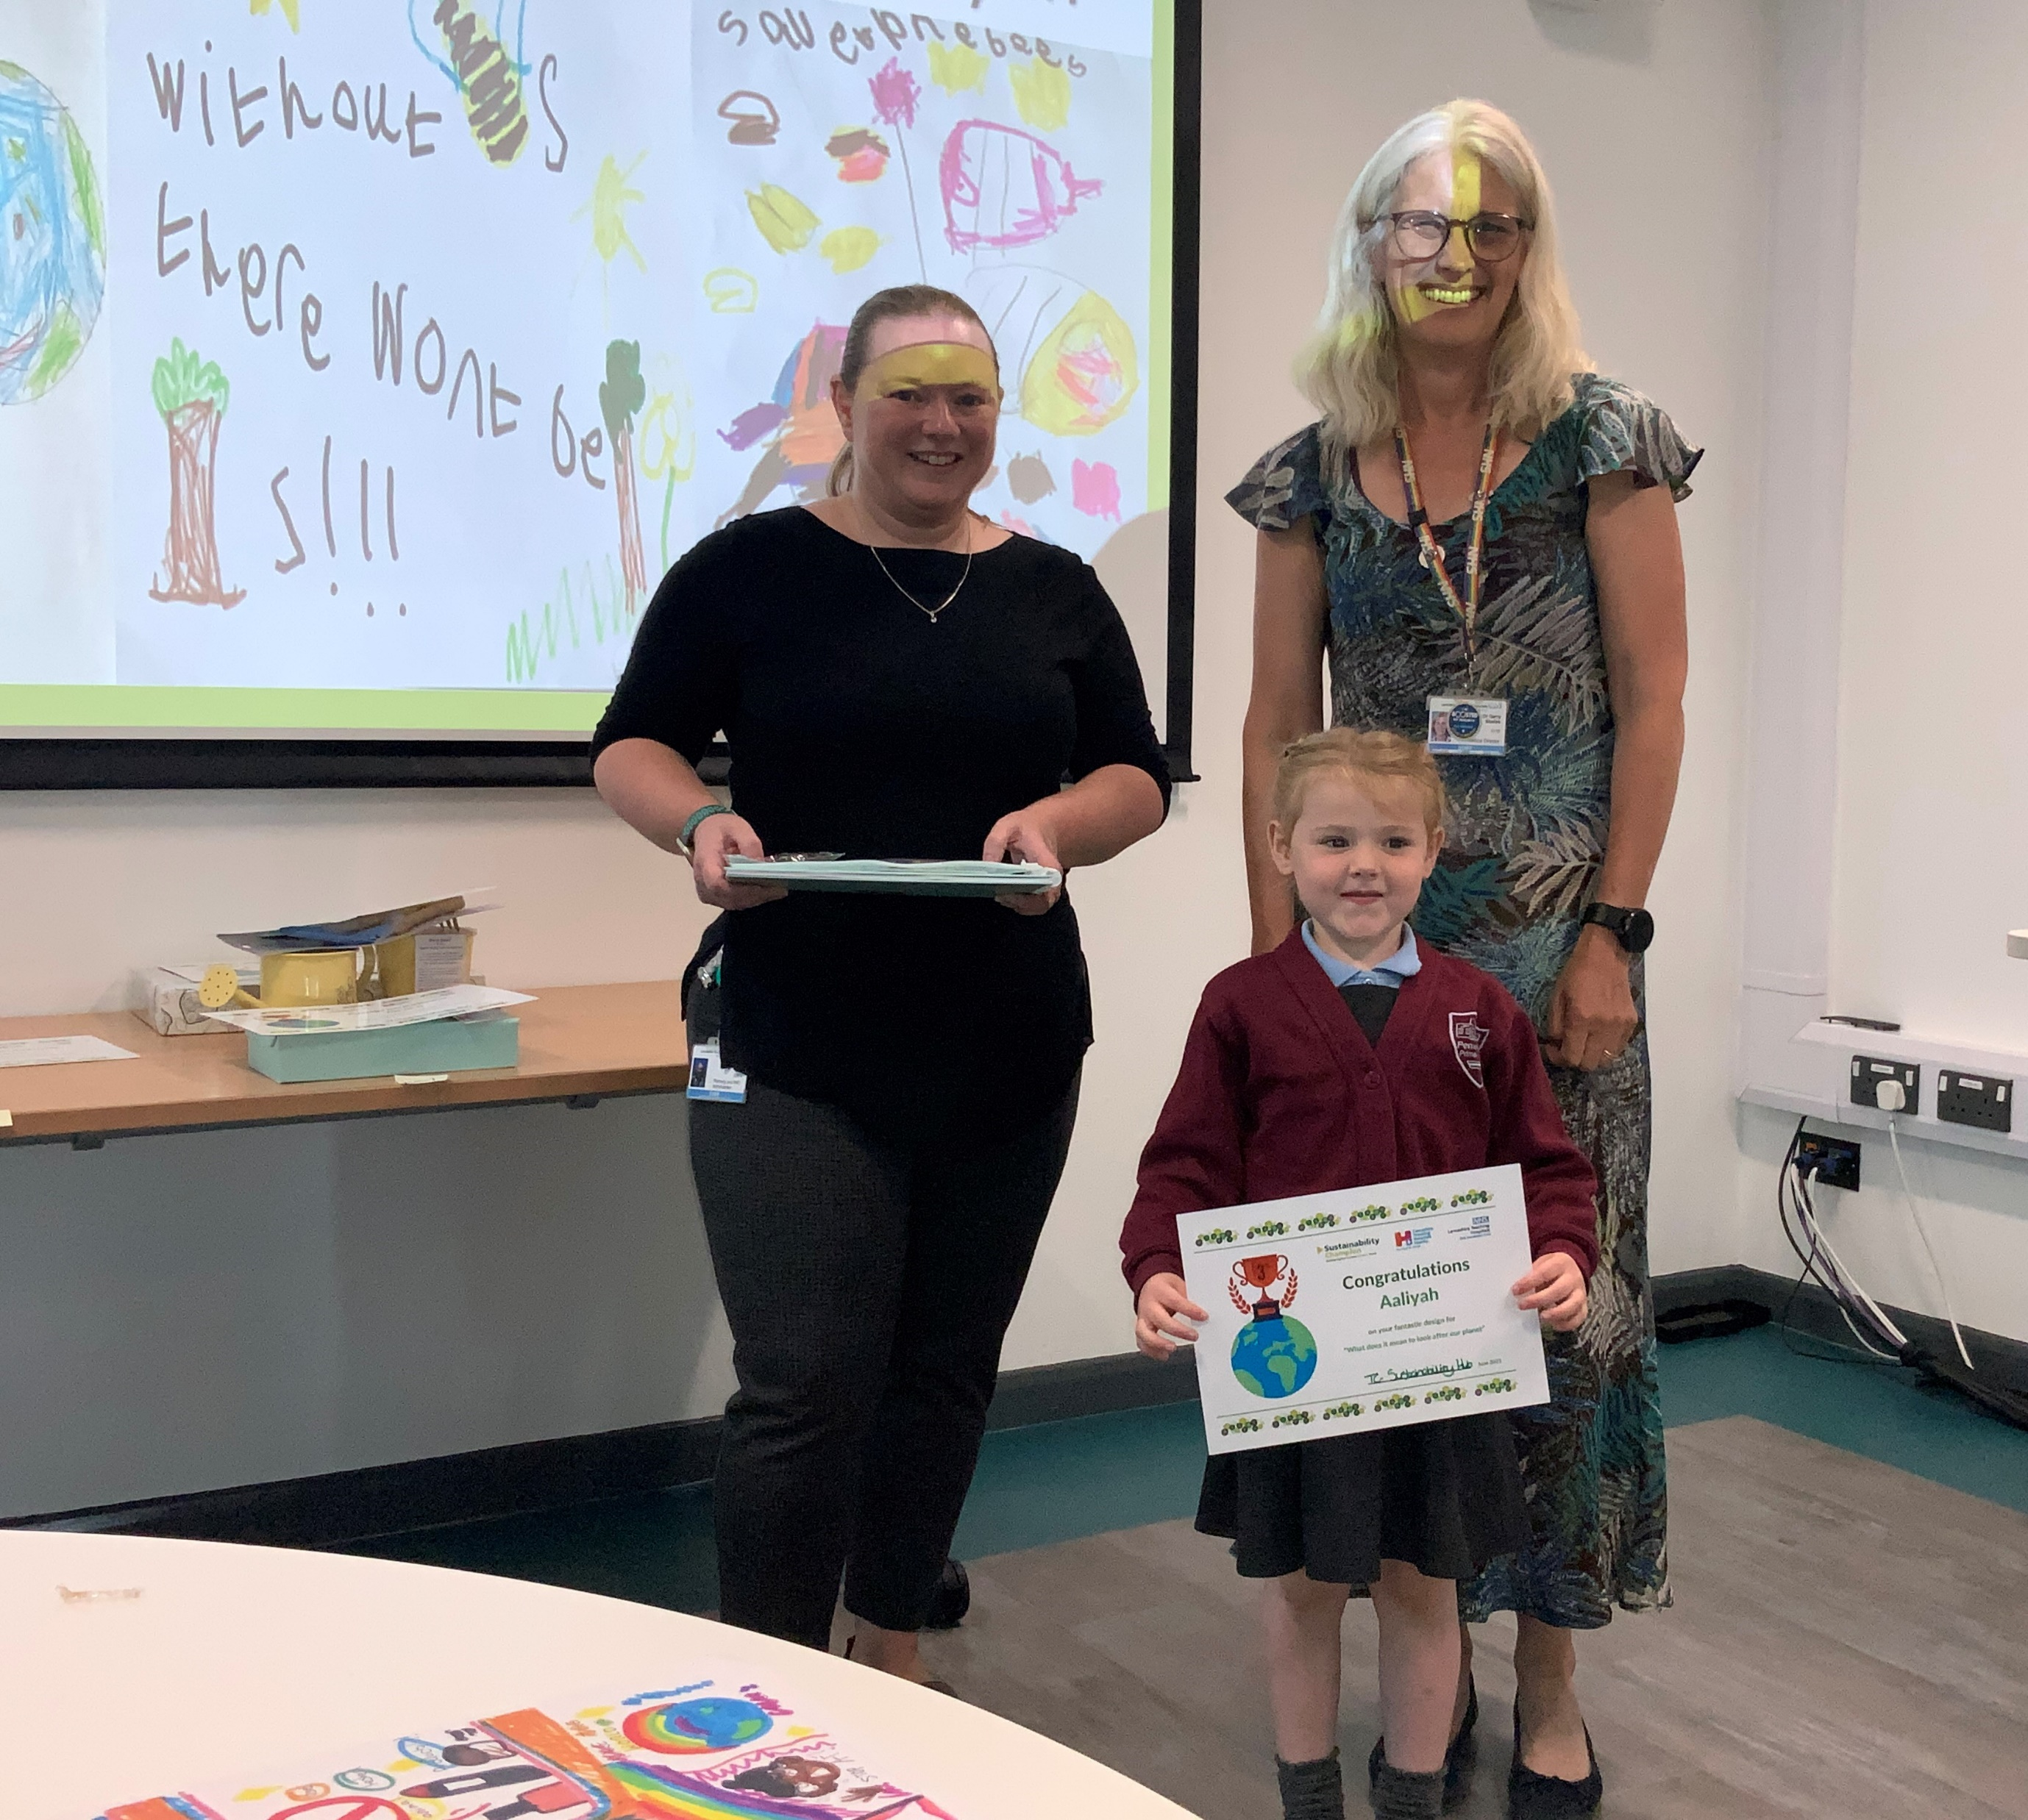
Winners - Category: EYFS
1st Place
Alfie - Euxton CE Primary School
2nd Place
Austin - Penwortham Primary School
3rd Place
Aaliyah – Penwortham Primary School

Slide 4
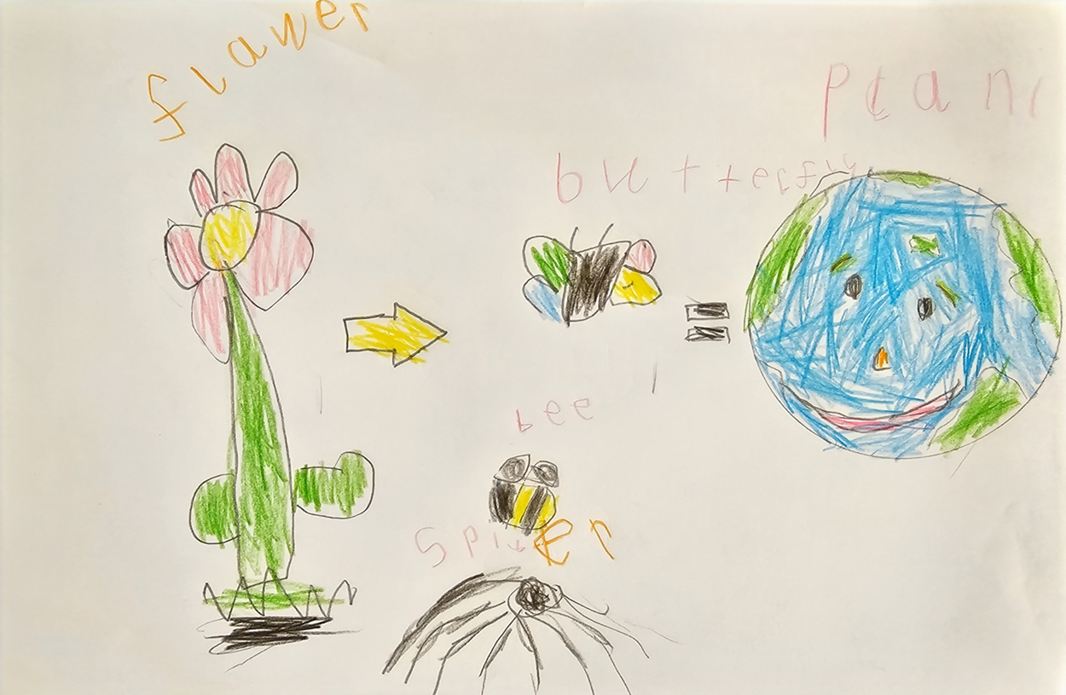
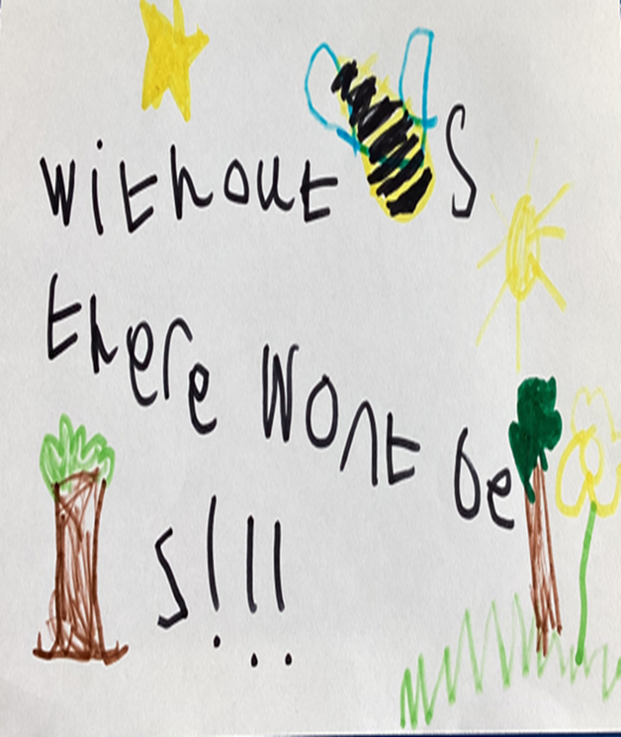
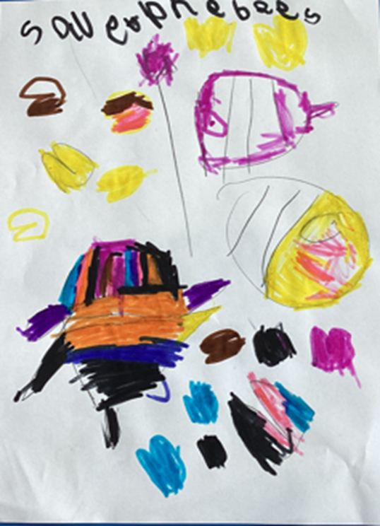
EYFS
1ST 2ND 3RD
Alfie Austin Aaliyah

Slide 5
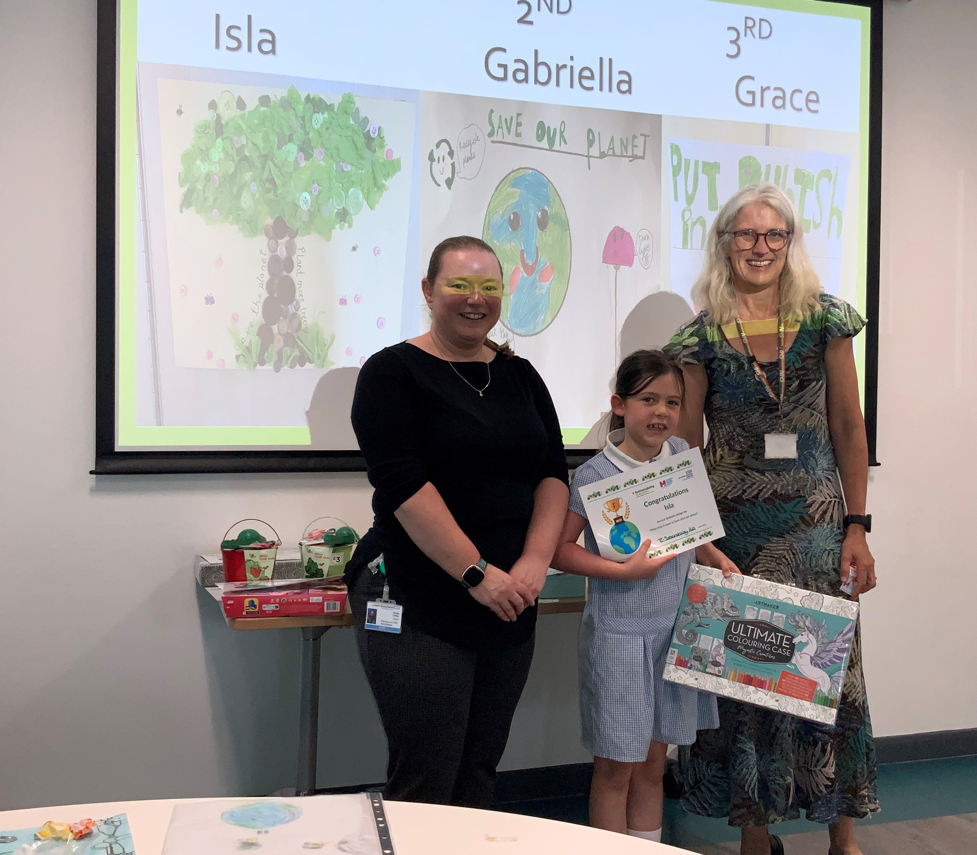
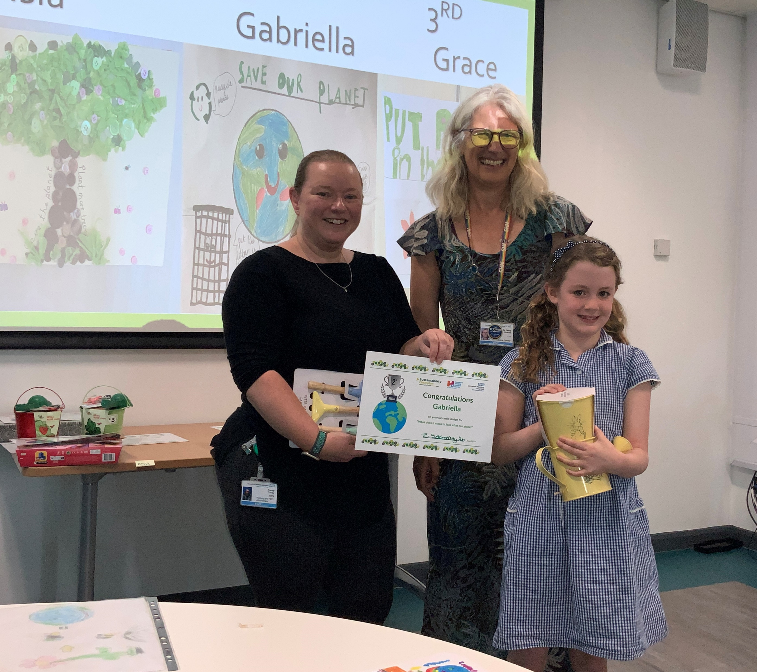
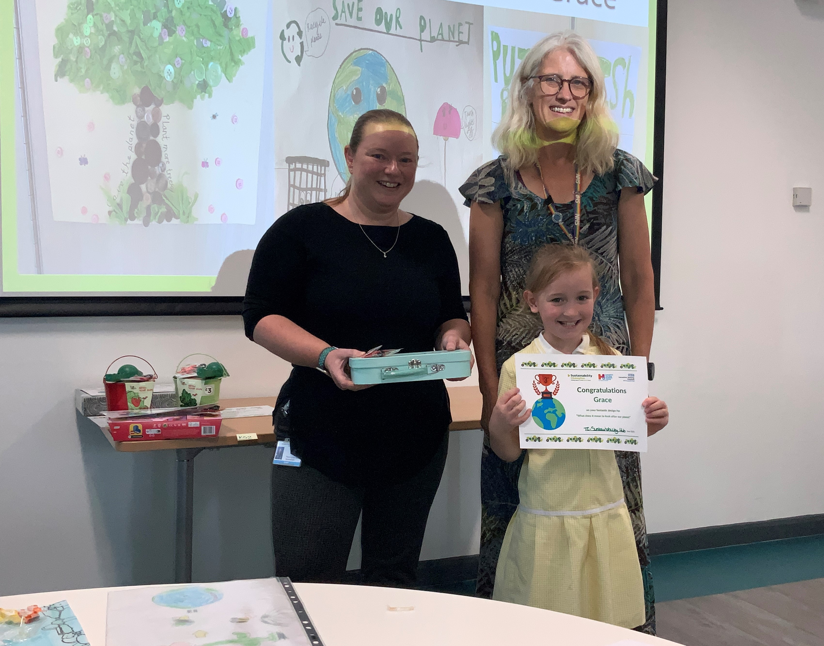
Winners - Category: Key Stage 1
1st Place
Isla –
Lea Endowed Primary School
2nd Place
Gabriella – Sherwood Primary School
3rd Place
Grace –
Lea Endowed Primary School

Slide 6
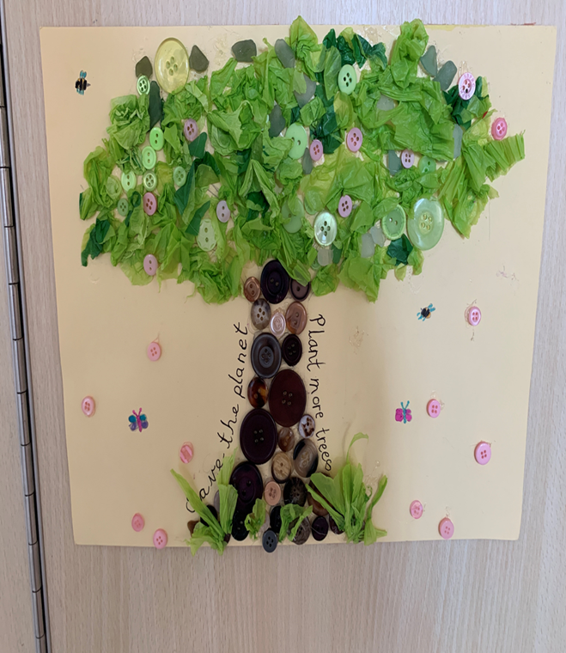
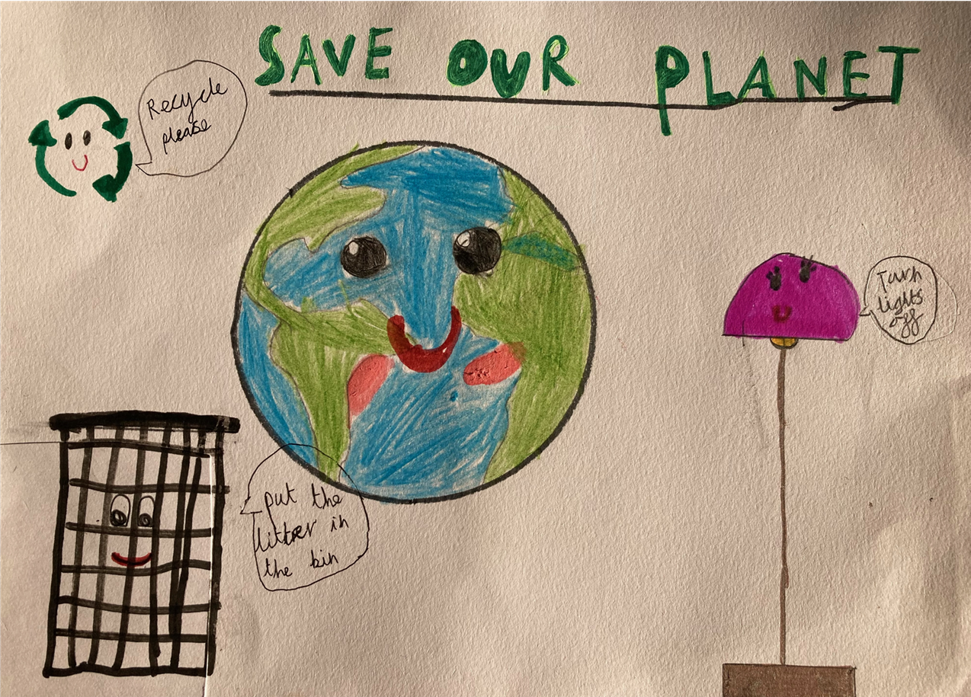
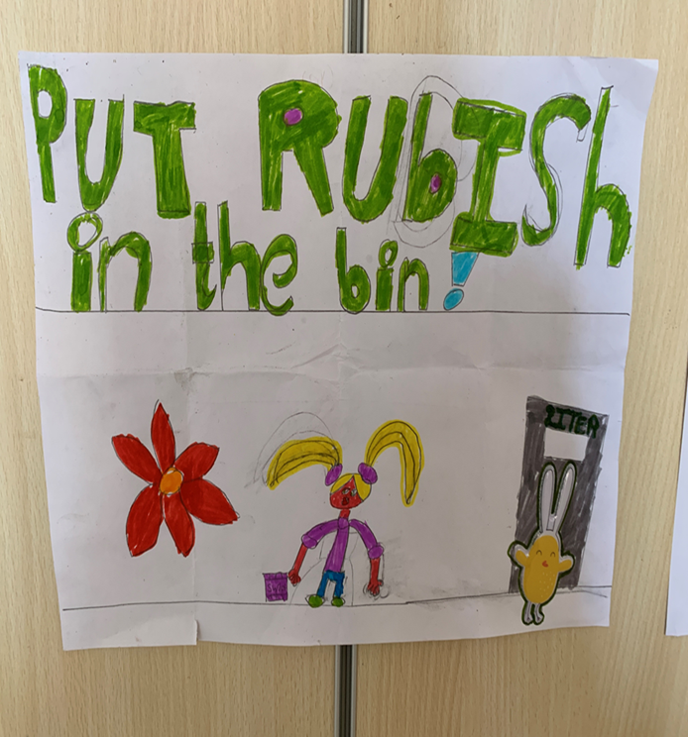
KS1
1ST 2ND 3RD
Isla Gabriella Grace

Slide 7
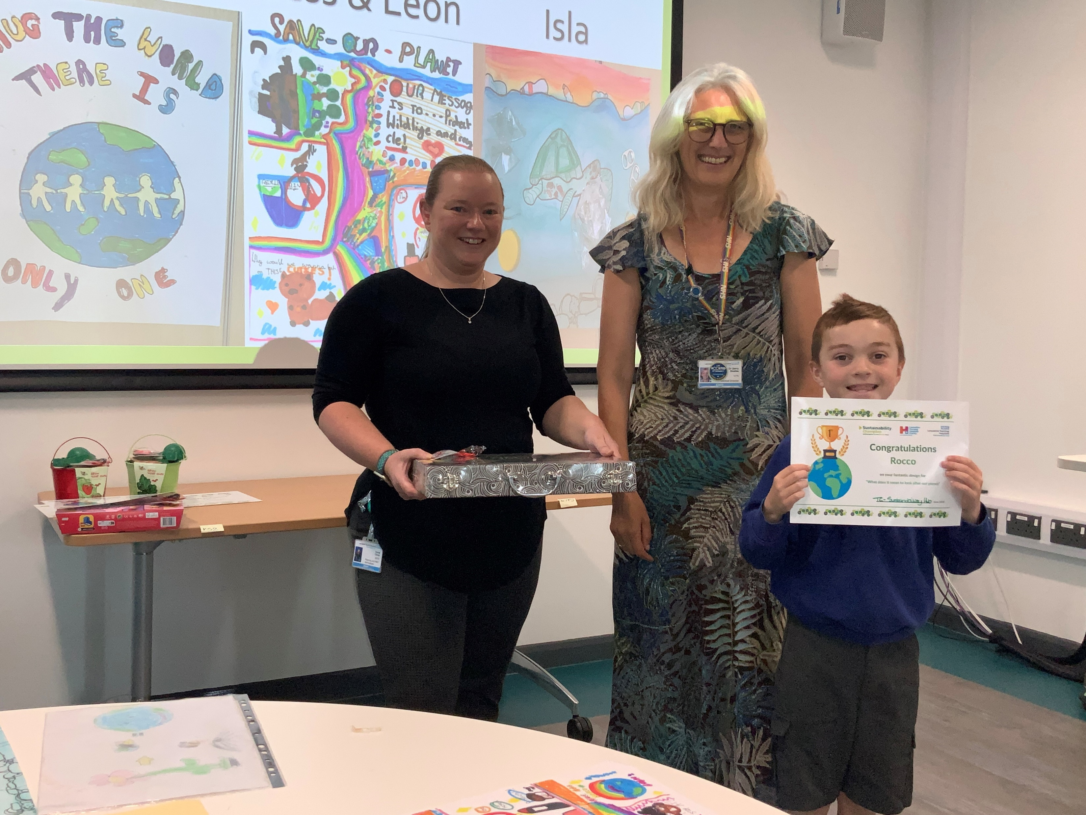
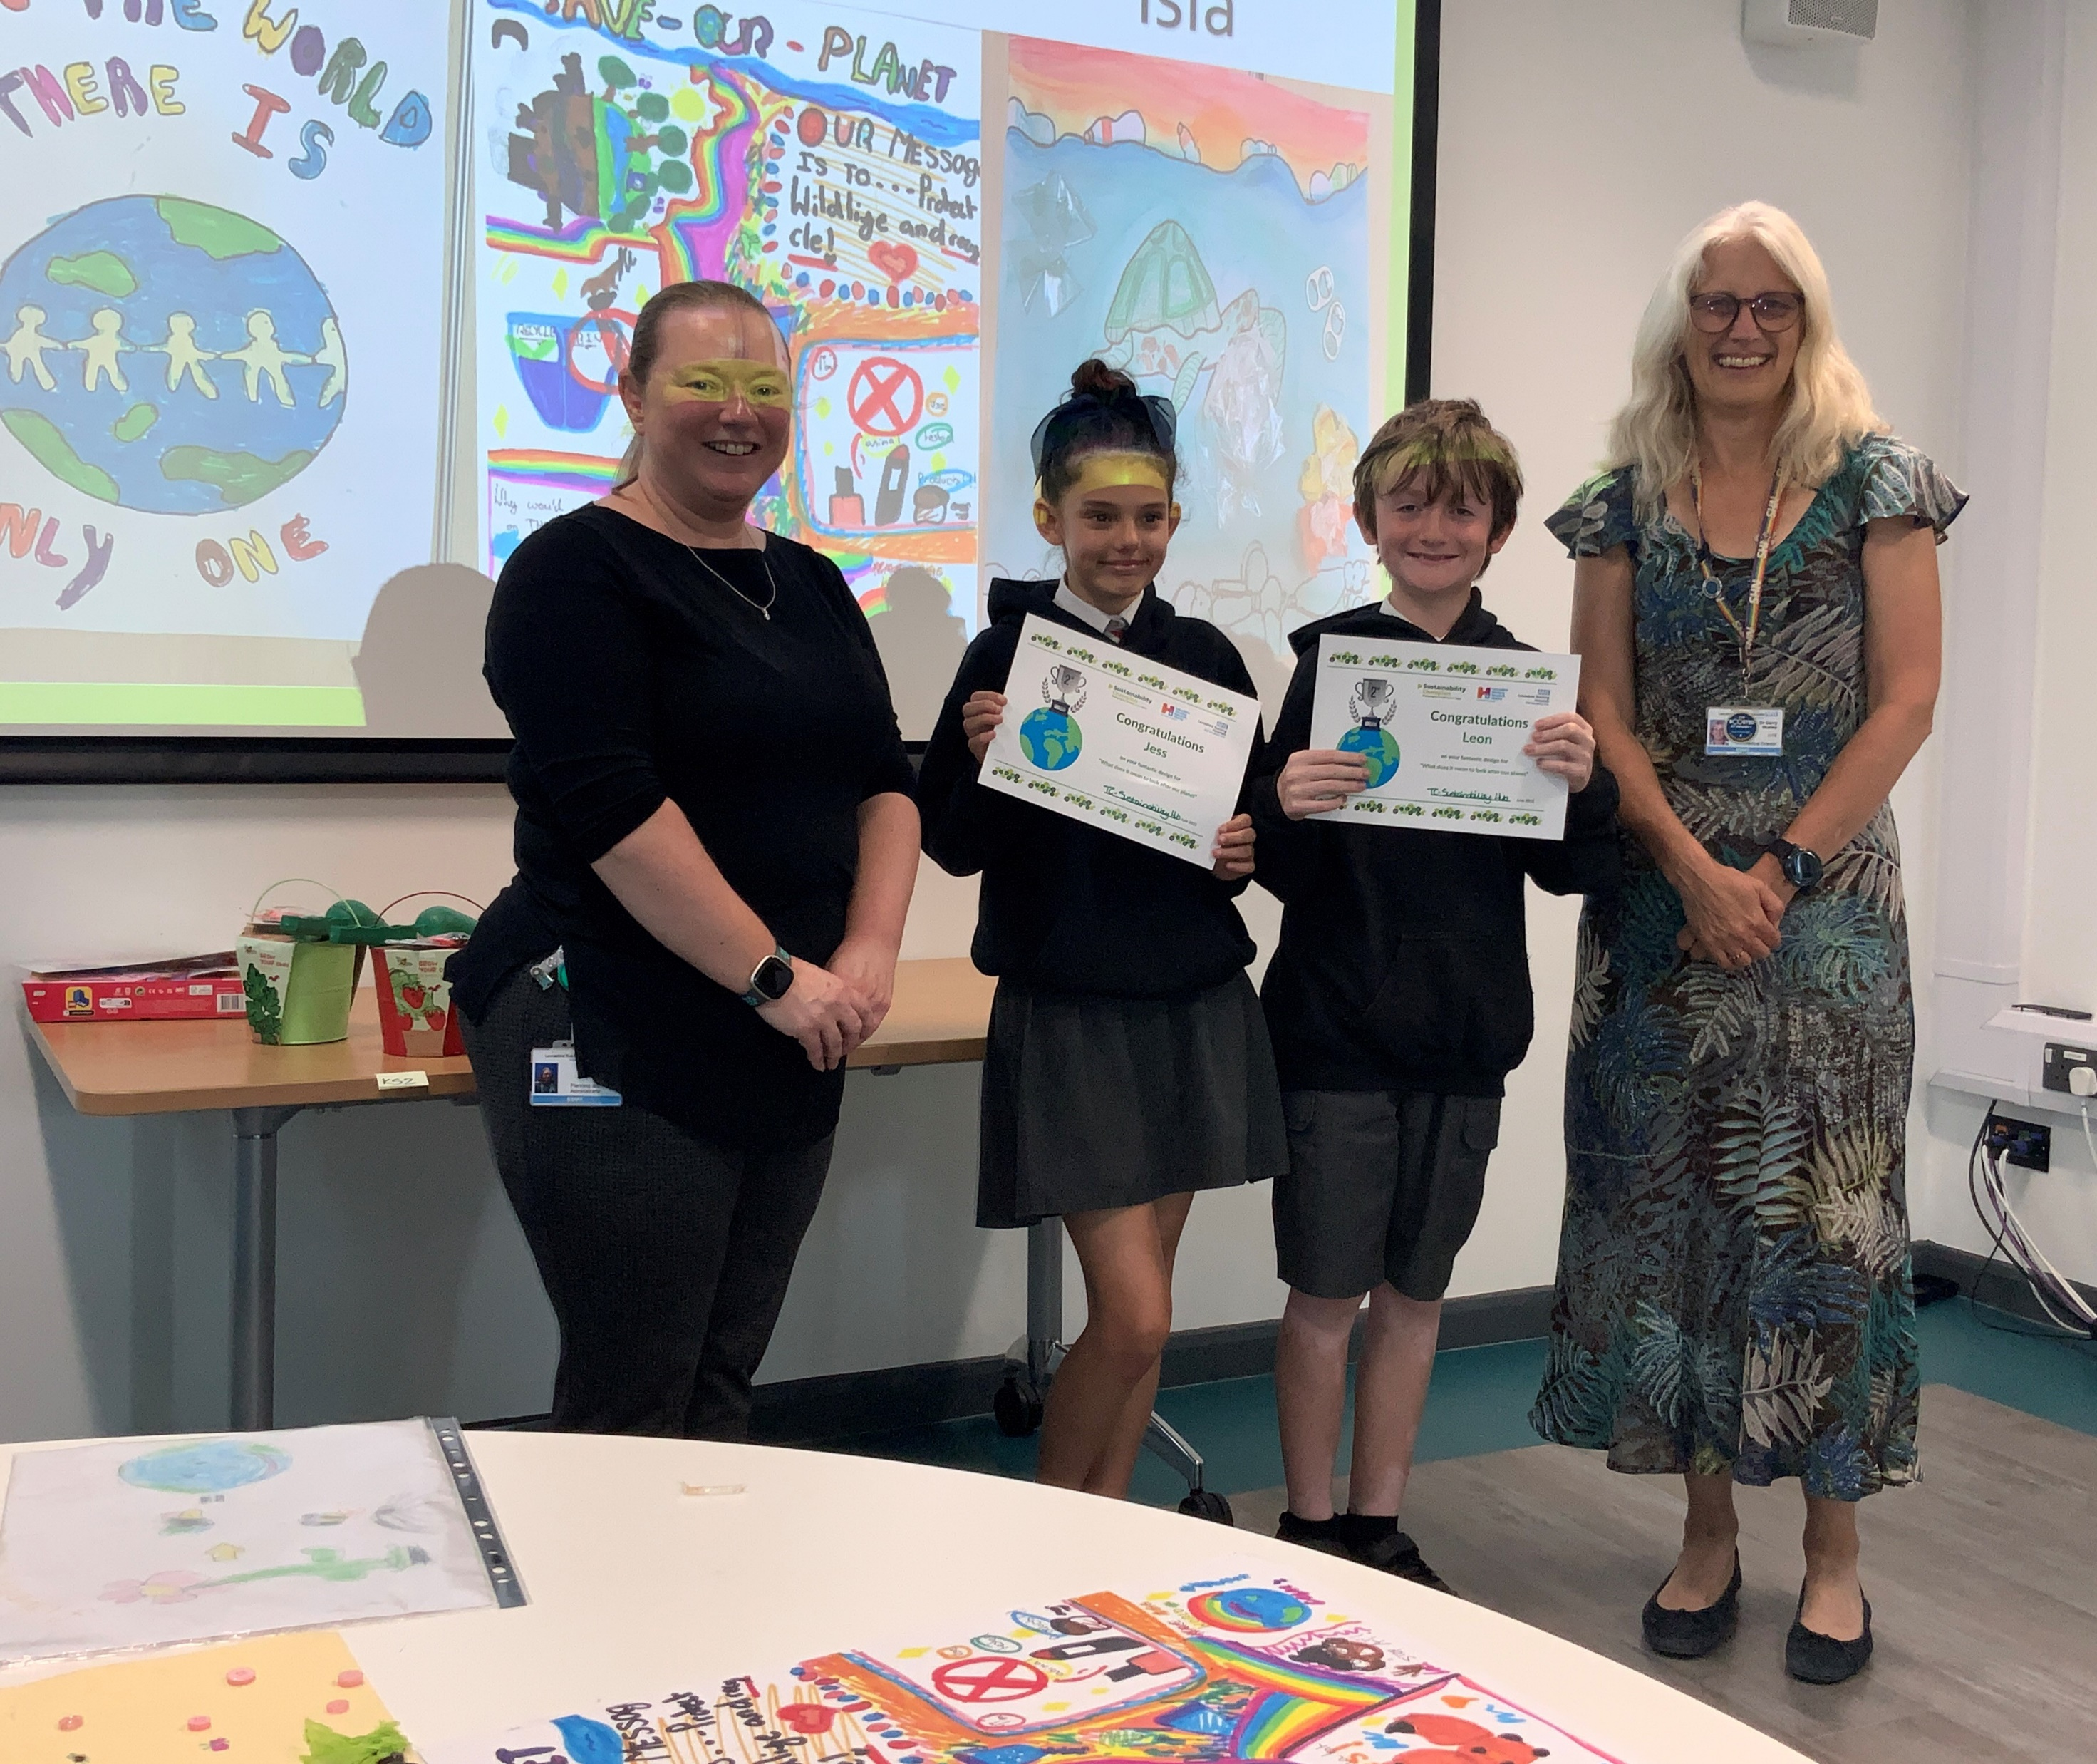
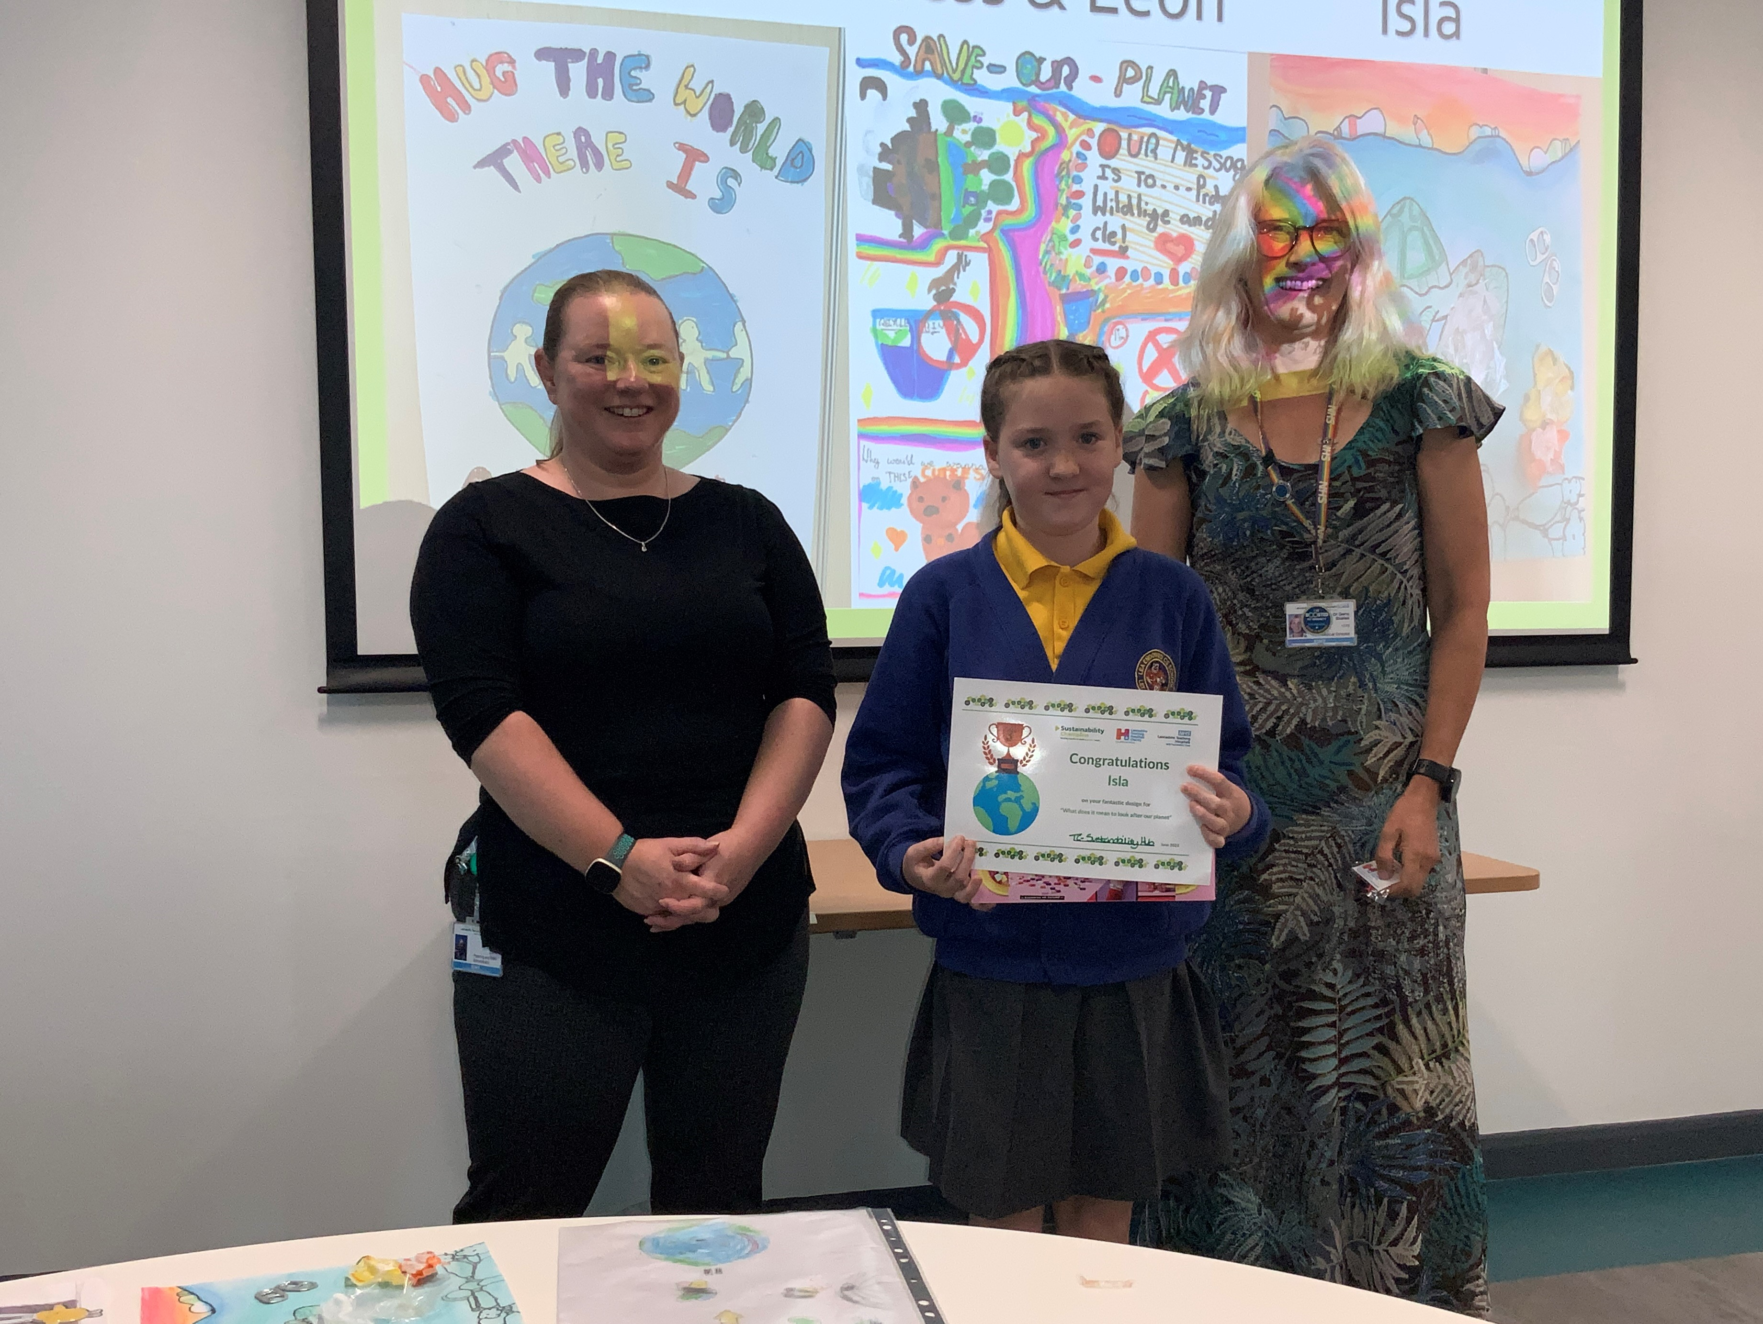
Winners - Category: Key Stage 2
1st Place
Rocco –
Lea Endowed Primary School
2nd Place
Jess and Leon –
Kingsfold Primary School
3rd Place
Isla –
Lea Endowed Primary School

Slide 8
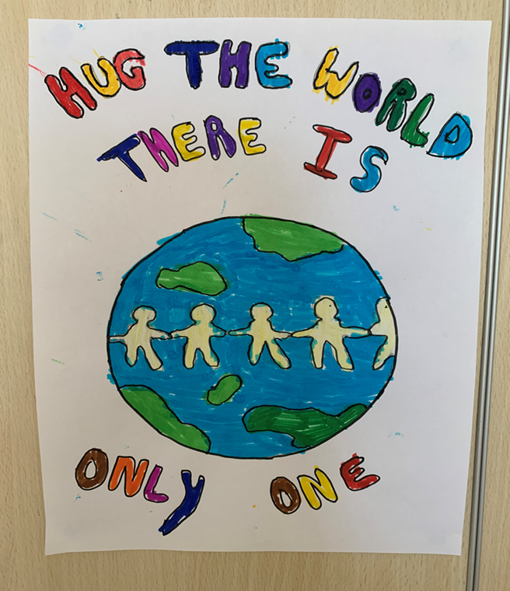
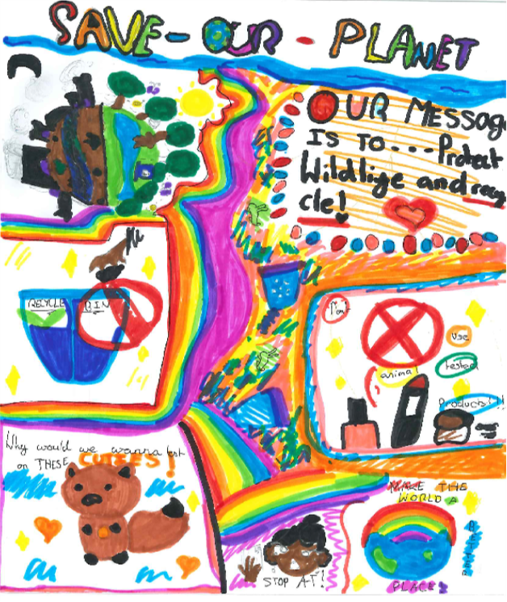
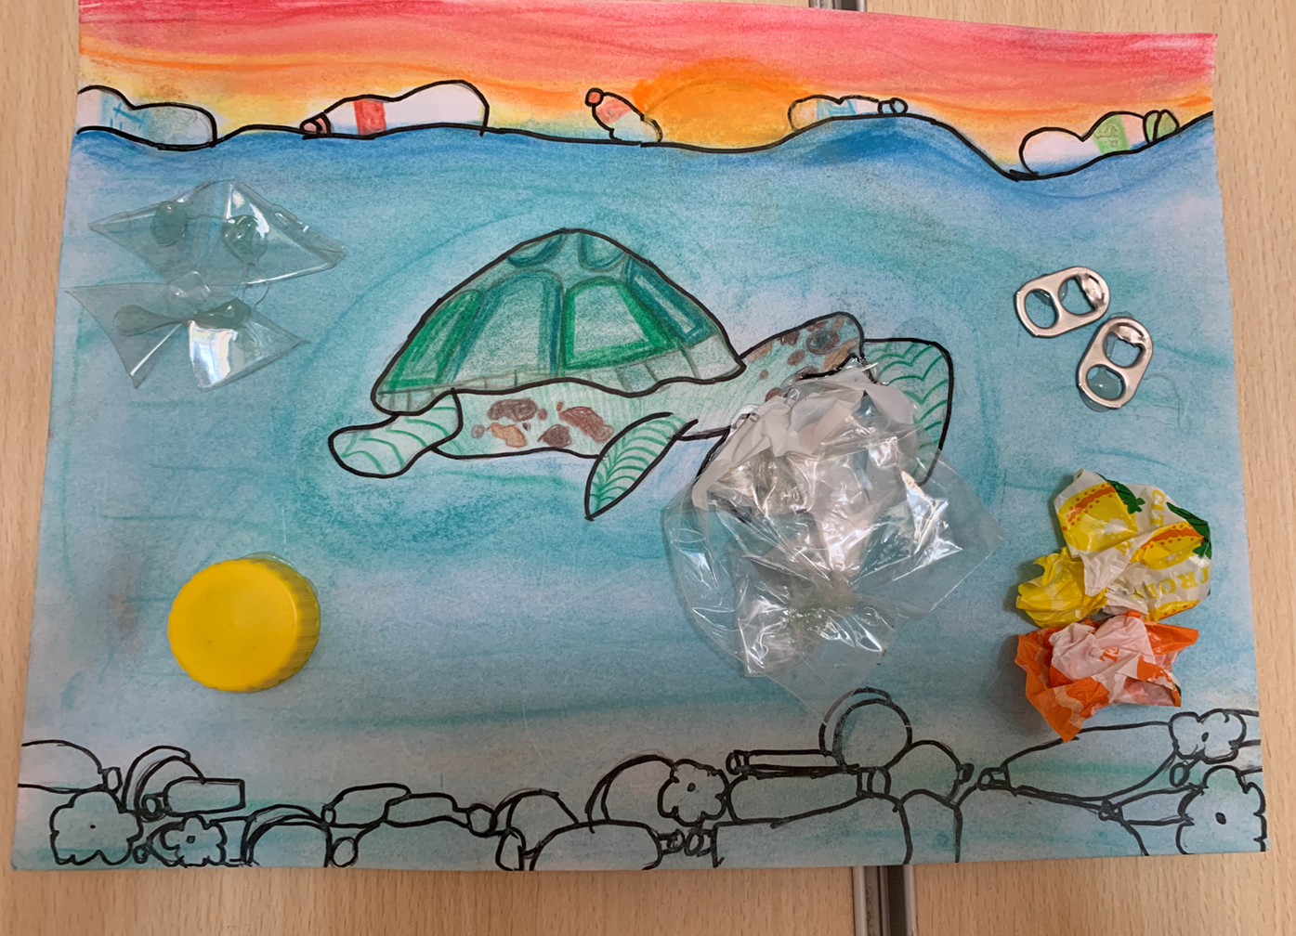
KS2
1ST 2ND 3RD
Rocco Jess & Leon Isla

